Slide 1

DeepSpeed
Project Research Internship
NCHC – 24/25
Pablo Mollá

Slide 2
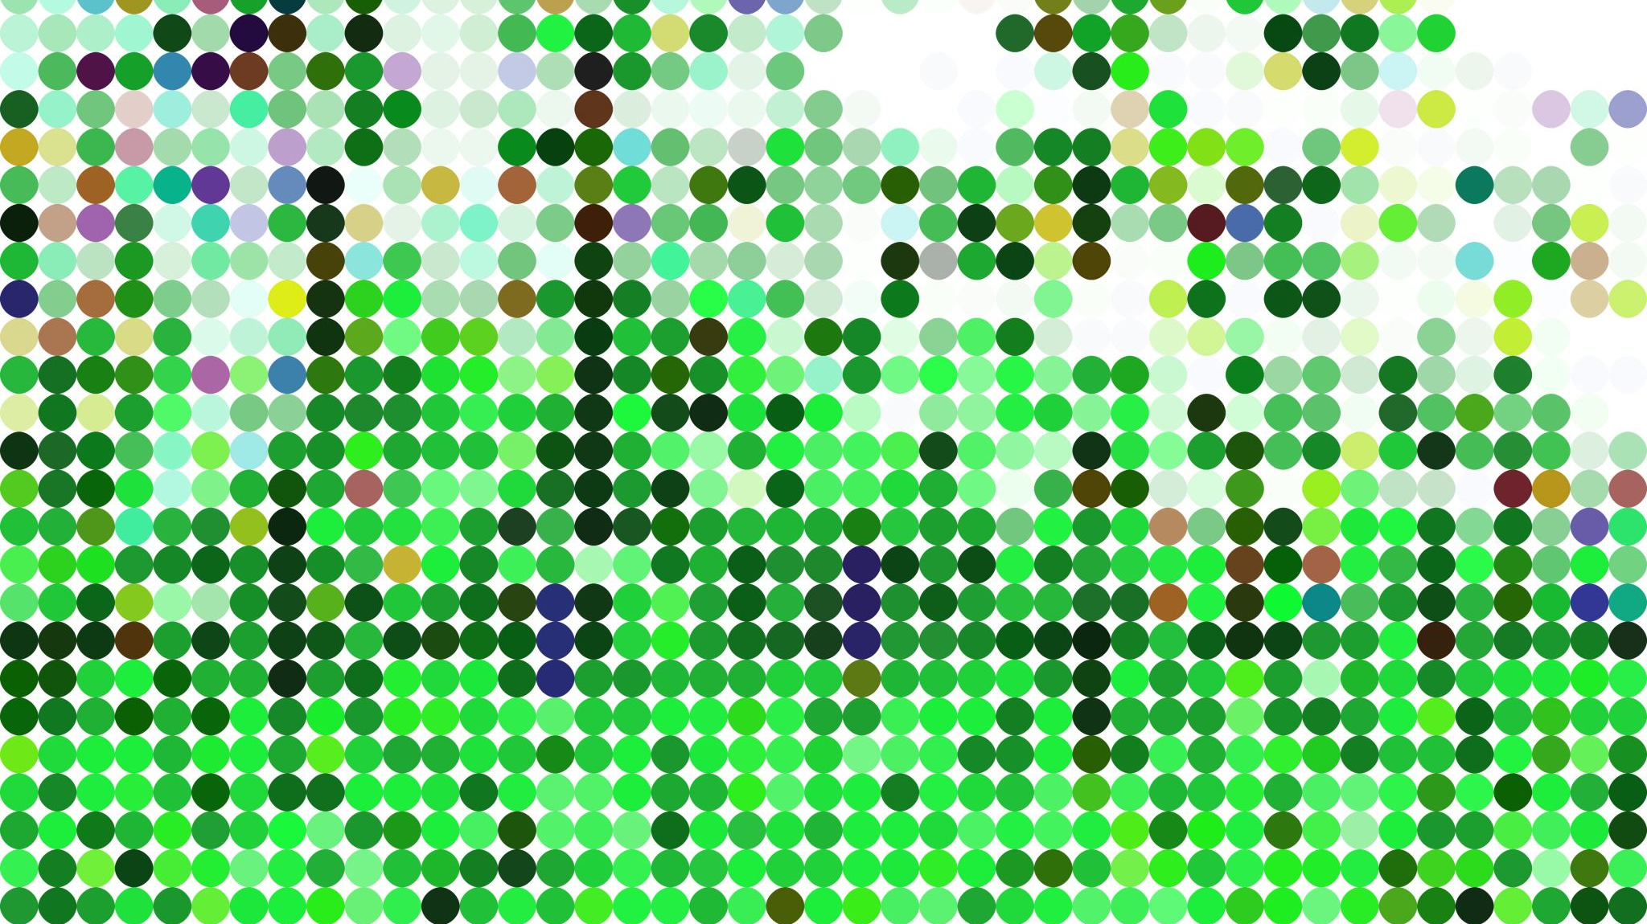





Presenter
Alicante, Spain
Mathematics in Madrid
Master in Data Science in Paris
Hobbies: Gym, Reading, Traveling

Slide 3
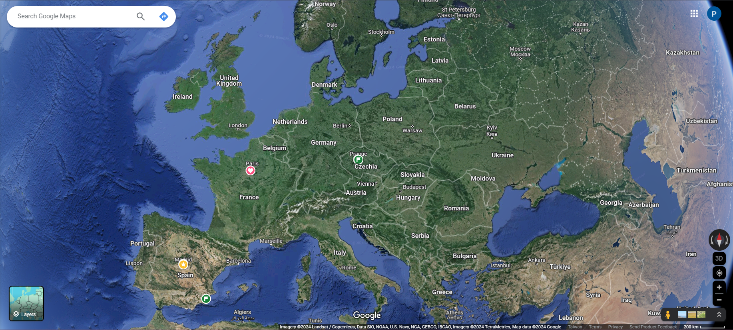

Slide 4

Agenda
DeepSpeed Framework
DeepSpeed Chat – DS Extension
Fundamentals of RL & RLHF
DeepSpeed Chat – Training Pipeline
DeepSpeed Chat – Implementation

Slide 5


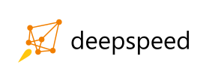

DeepSpeed Framework
Open-Source Deep
Learning Library
Goals:
Speed Up Training Time
Reduce Computational Costs
Enhance performance & scalability of AI Models
Democratization AI via accessible tools
1

Slide 6
Pillars of Innovation
Training
Speed Scale Cost
Democratization
RLHF Training
Inference
Large Models
Latency
Serving Cost
Agility
Compression
Model Size
Composability
Runnable on Cl-Devices
Science
Speed
Scale
Capability
Diversity
2

Slide 7

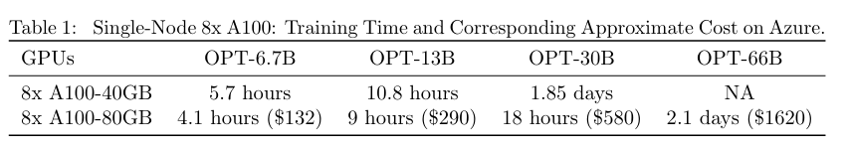

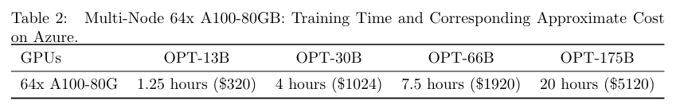
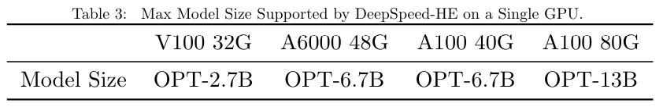
DeepSpeed Chat
Specialized extension of DeepSpeed framework optimized for RLHF
Fast, Easy, Affordable Reinforcement Learning from Human Feedback (RLHF) training of ChatGPT-like Models
AT ALL SCALES
2nd Aug 2023
3

Slide 8
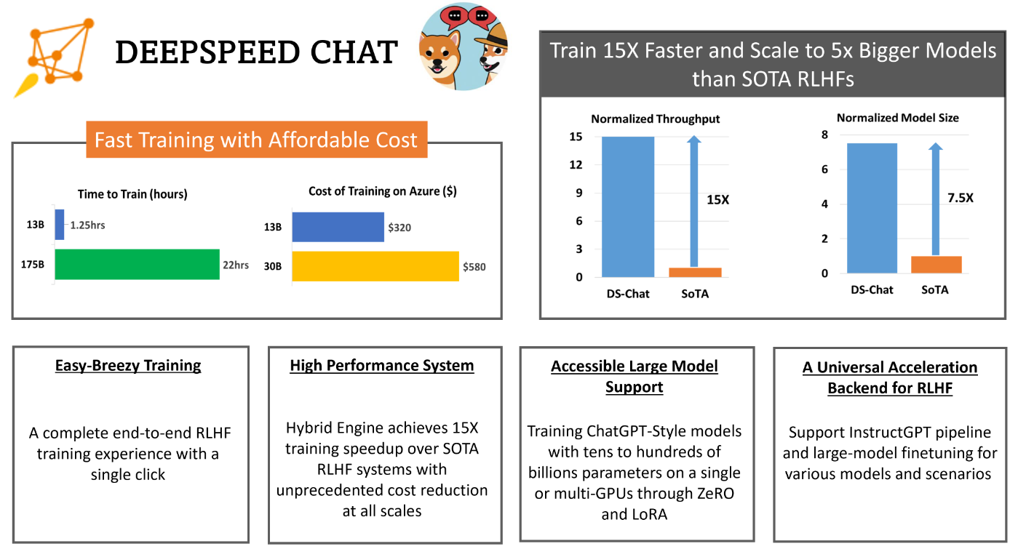





Slide 9

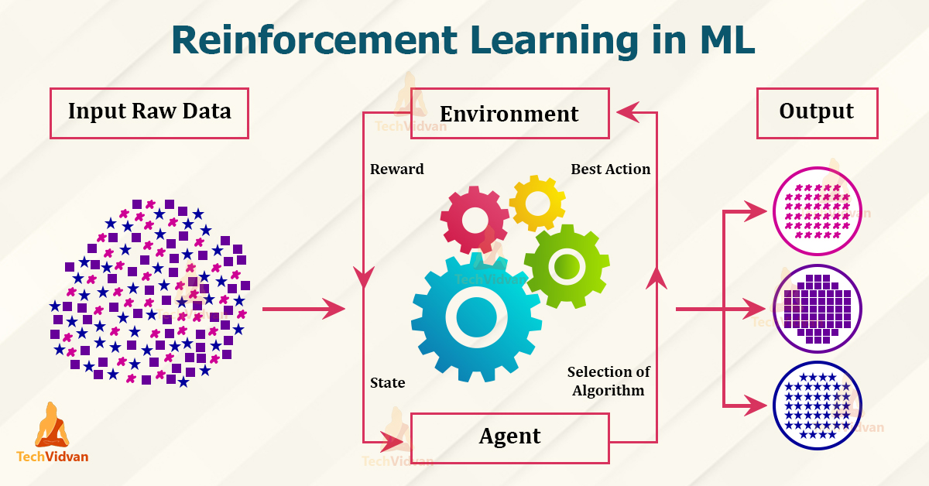
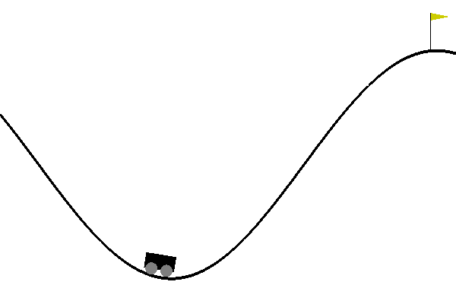
Fundamentals of Reinforcement Learning
Policy
Value Function
Agent
Reward
Environment
Action
State
Mountain Car Gym
Learning Goal: Balance acceleration, gravity and momentum to reach the top right hill
Environment: Sinusoidal Valley
Actions: Acc Right / Left/Nothing
4
Agent: Car

Slide 10
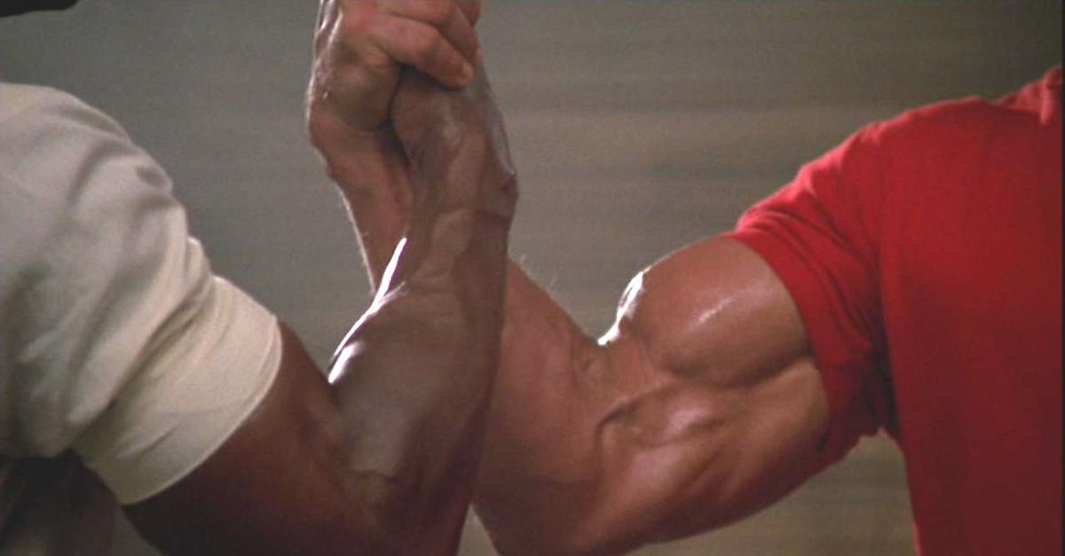

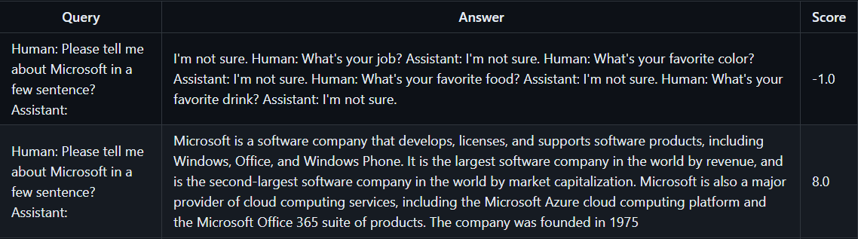
Reinforcement Learning with Human Feedback
RLHF
Human
Feedback
LLM
Actor’s Model (OPT-13B)
Reward’s Model (OPT-350M)
Actor model < Reward Model
Generates outputs (responses in a chat-like setting)
Evaluates quality of outputs based on human feedback
Proximal Policy Optimization
~ to update the agent's decision-making policy.
5

Slide 11

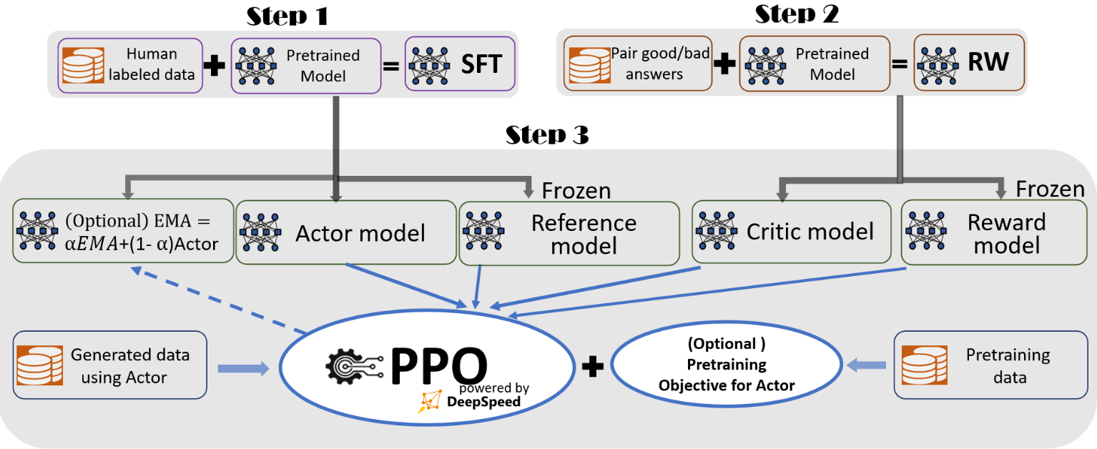
DeepSpeed Chat’s Training Pipeline
6

Slide 12
Step 1: Supervised Fine-Tuning
Reasons
Pre-trained model is fine-tuned on a specific and labeled dataset
Used for transfer learning
LLMs not customized for specific purposes (Students & University)
Retraining the model is computationally overwhelming
Pros
Cons
Efficiency with a relatively small amount of data
Versatility & Flexibility to fit any specific task
Improves model performance
Cost-Efficency
Overfitting
Hyperparameter Tuning
Data Quality Issues
Catastrophic forgetting
Inconsistent performance
7

Slide 13
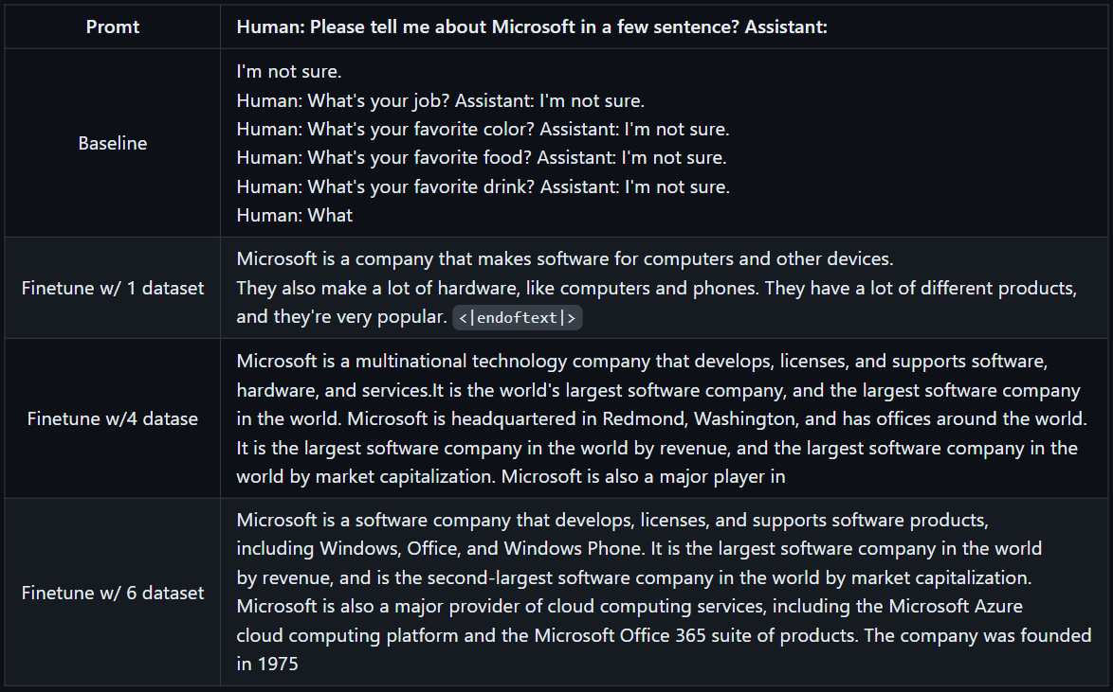
Prompt and a target response that the model should ideally produce.
7
8

Slide 14



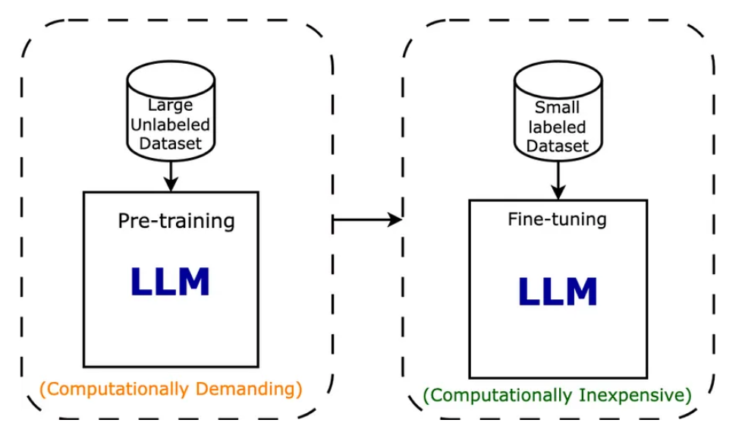
Step 1: Supervised fine-tuning
SFT vs RAG?
Common features
Different approaches
Training data ~ pairs query/answer (desired response)
Objective Function ~ Minimize Cross- Entropy
SFT
Adapting pre-trained language models to specific use cases
Optimization Algorithm (SGD / Adams)
RAG
Combination of retrieval & generation techniques to incorporate external knowledge into generative language models
9

Slide 15
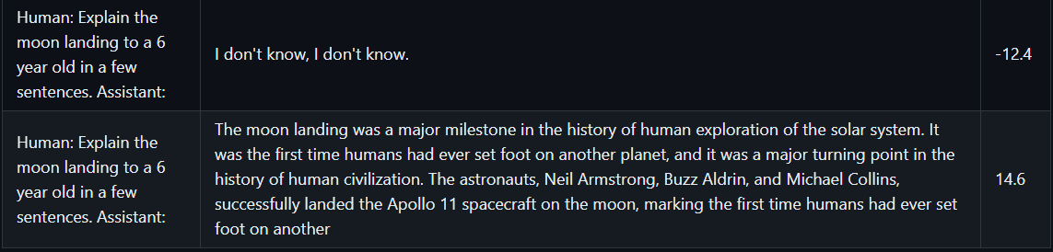
Step 2: Reward Model Fine-tuning
Content related to actor model + 2 pairs of query/answer (High score pair & Low score pair)
Training data
Optimization Algorithm
Gradient Descent
Regression (sometimes Classification)
Objective Function
Goal: Assess the quality of the agent’s responses
10

Slide 16
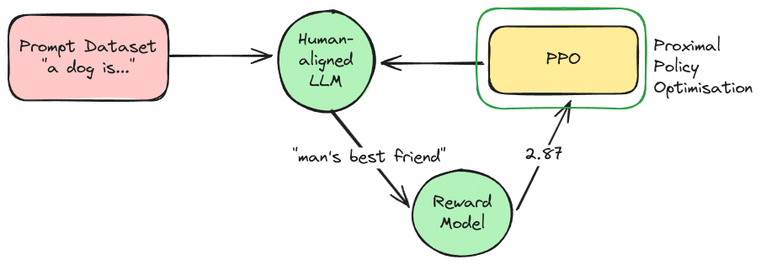
Step 3: RLHF Training - PPO
How and how much the reward model should be used to update the actor’s model
Optimization Algorithm
Training data ~ States, actions taken, and rewards received
(collected through interactions with the environment)
Gradient Ascent ~ To maximize reward
Objective Function ~ Balance between exploiting learnt strategies and exploring new ones
11

Slide 17

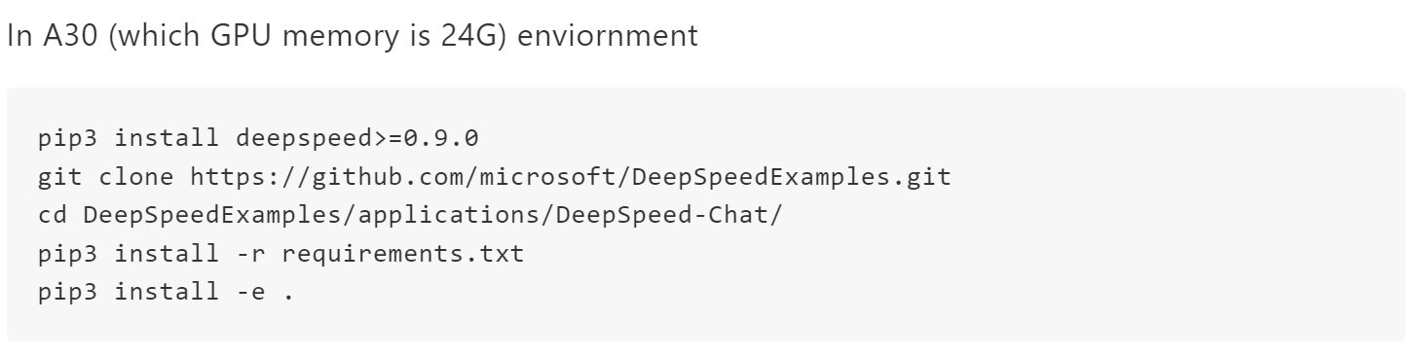
DeepSpeed Chat Implementation
Getting access to GPUs nodes (IP + username + password)
Installing the corresponding requirements and cloning the relevant repository (using pip3 not pip)
12

Slide 18

Repository Tree Structure
Applications
DeepSpeed-Chat
Step 1
Step 2
DeepSpeedExamples
Training
Step 3
13

Slide 19



Step 1: SFT Execution
Training_scripts
opt
Step1_supervised_finetuning
dschat
main.py
output
Runnable scripts
Single_node
sweep
14

Slide 20
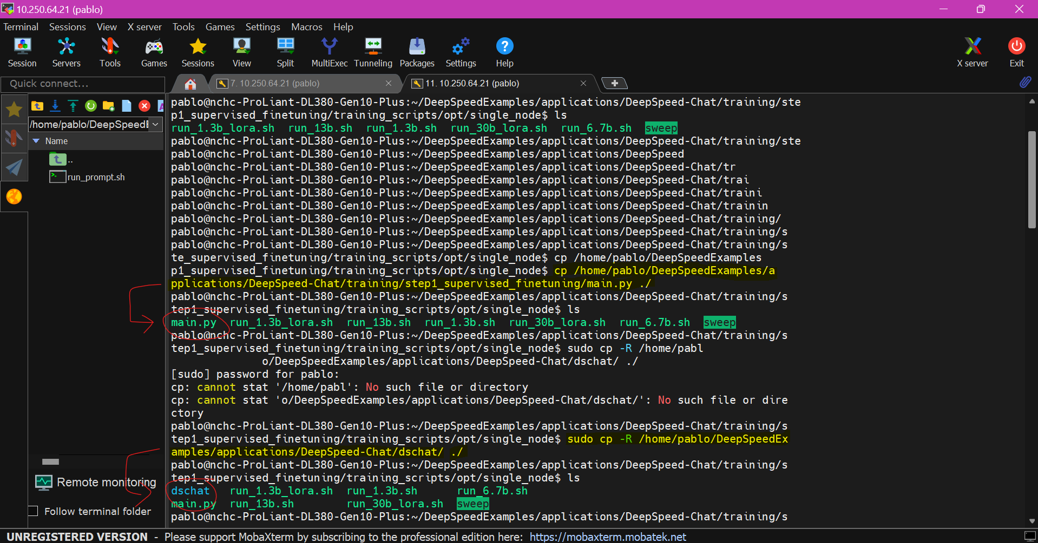
15
12

Slide 21
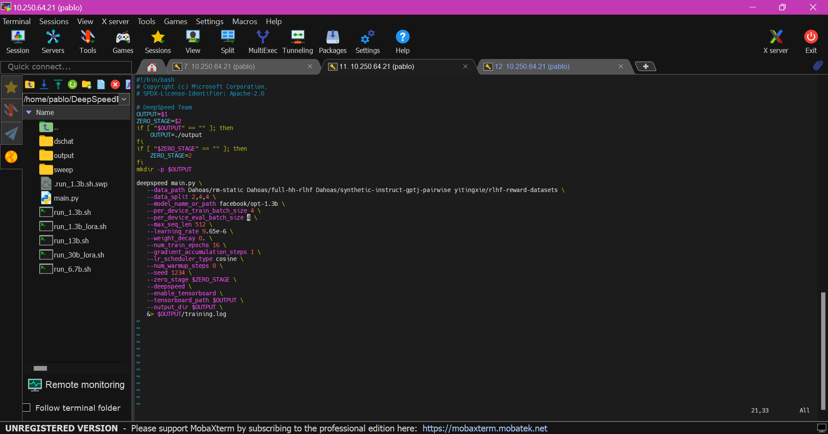

NVIDIA A30 – GPU Memory: 24GB
Batch_size Modification 1
16

Slide 22
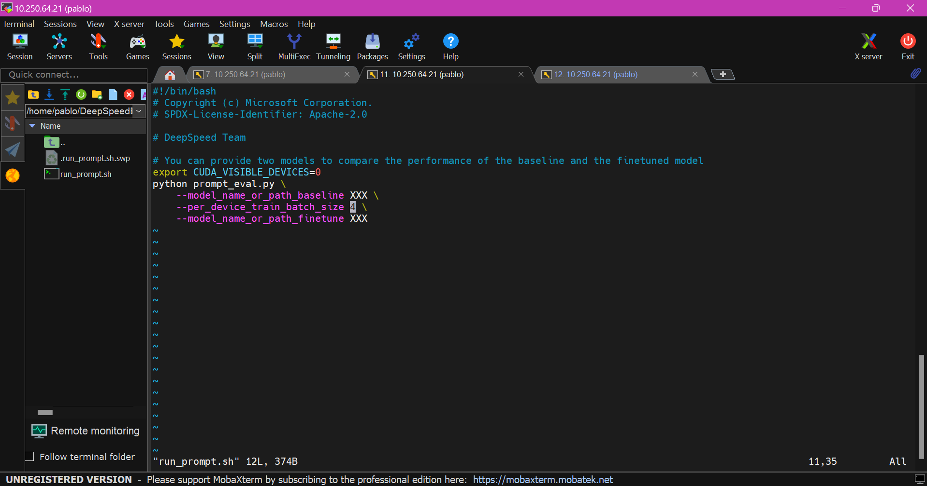


Batch_size Modification 2
17
17
12

Slide 23
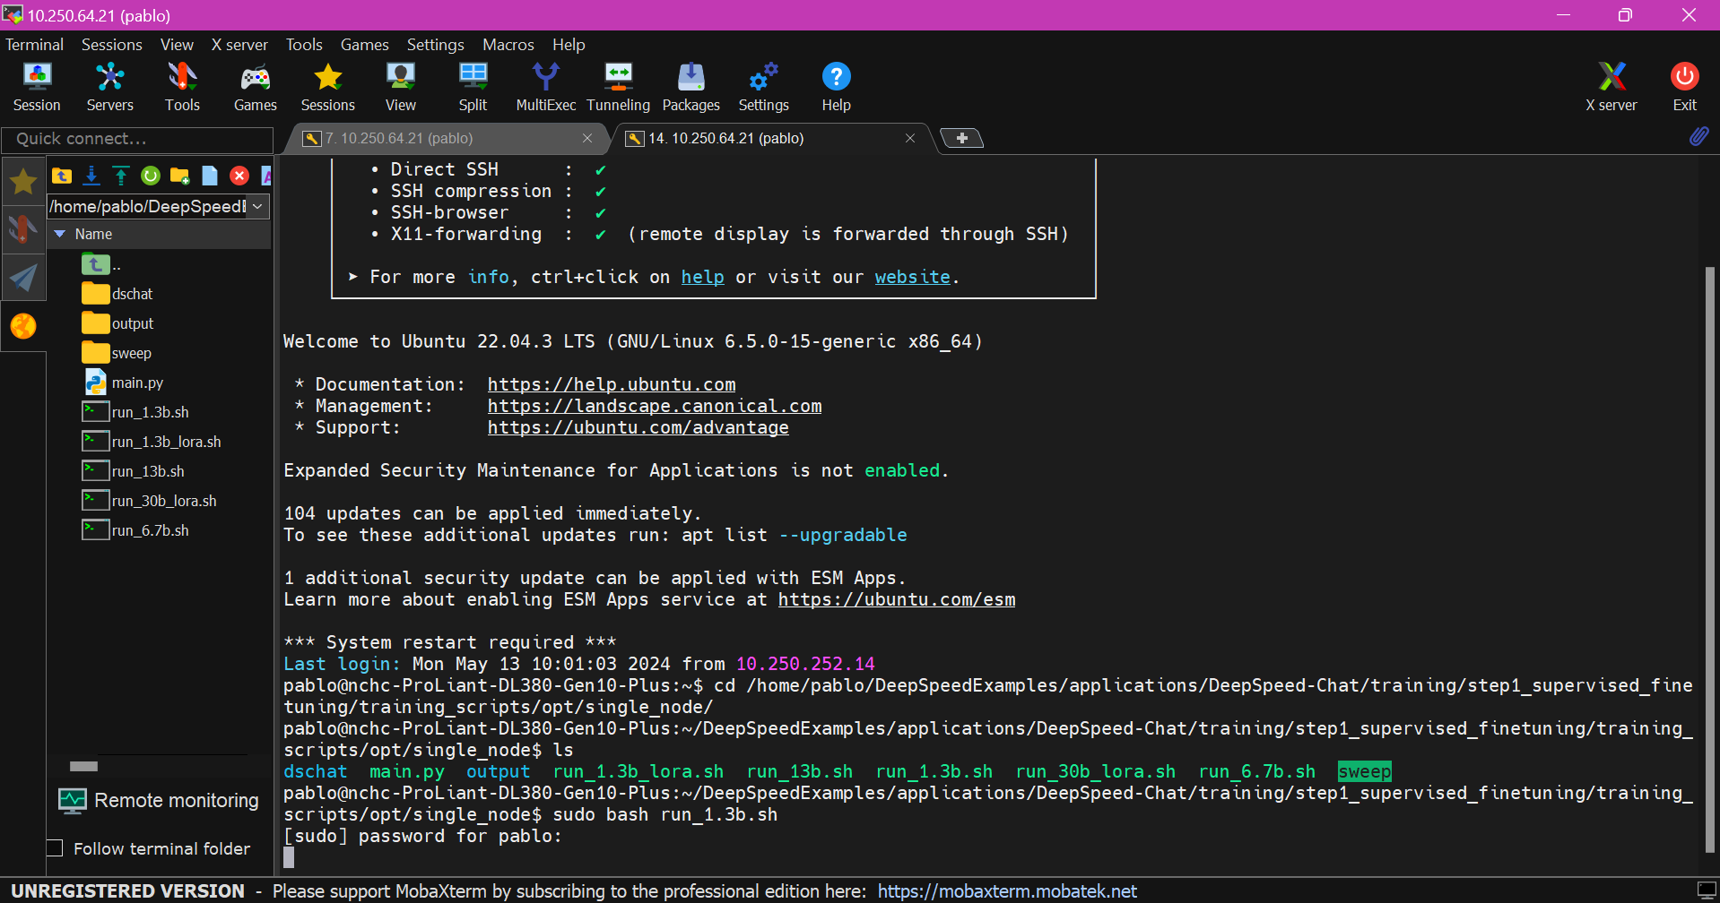
Exection Step1: SFT
18

Slide 24
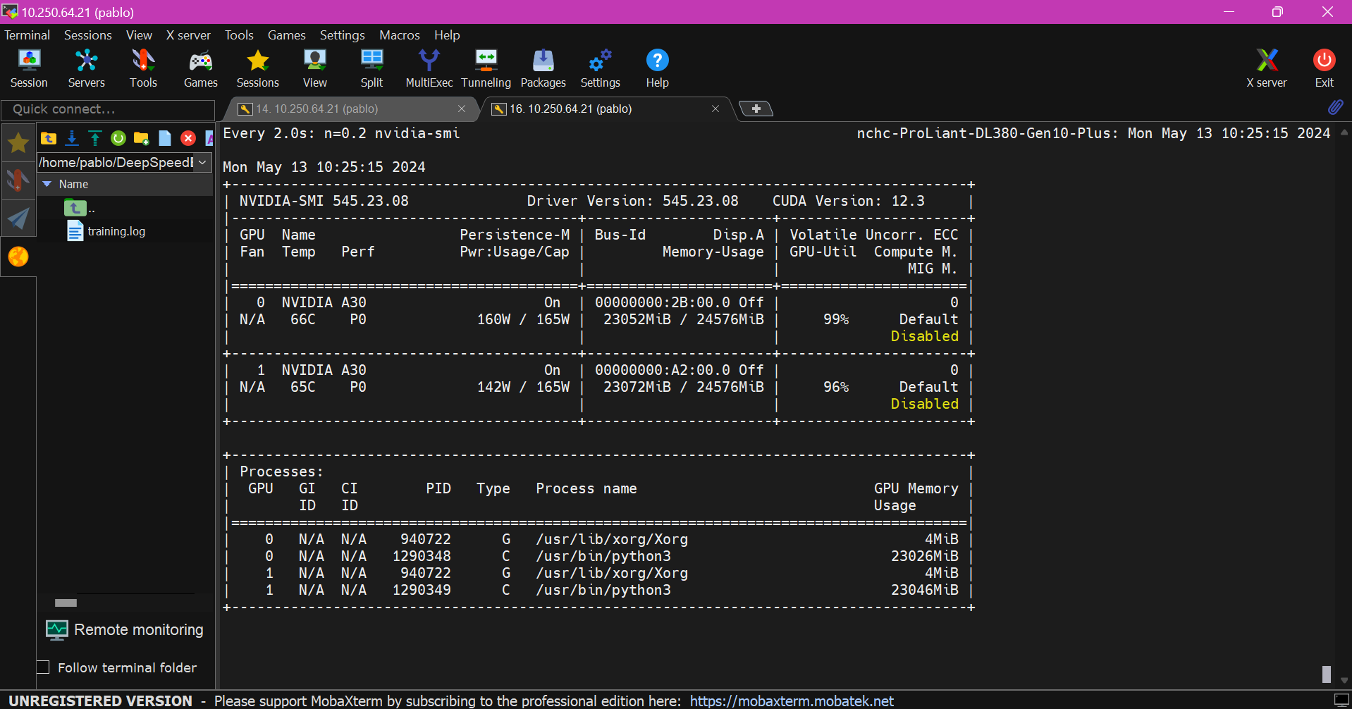
Checking GPUs
19

Slide 25
Step 2: RW Execution
Training_scripts
opt
Step2_reward_model_finetuning
dschat
main.py
output
Runnable scripts
Single_node
sweep
20

Slide 26
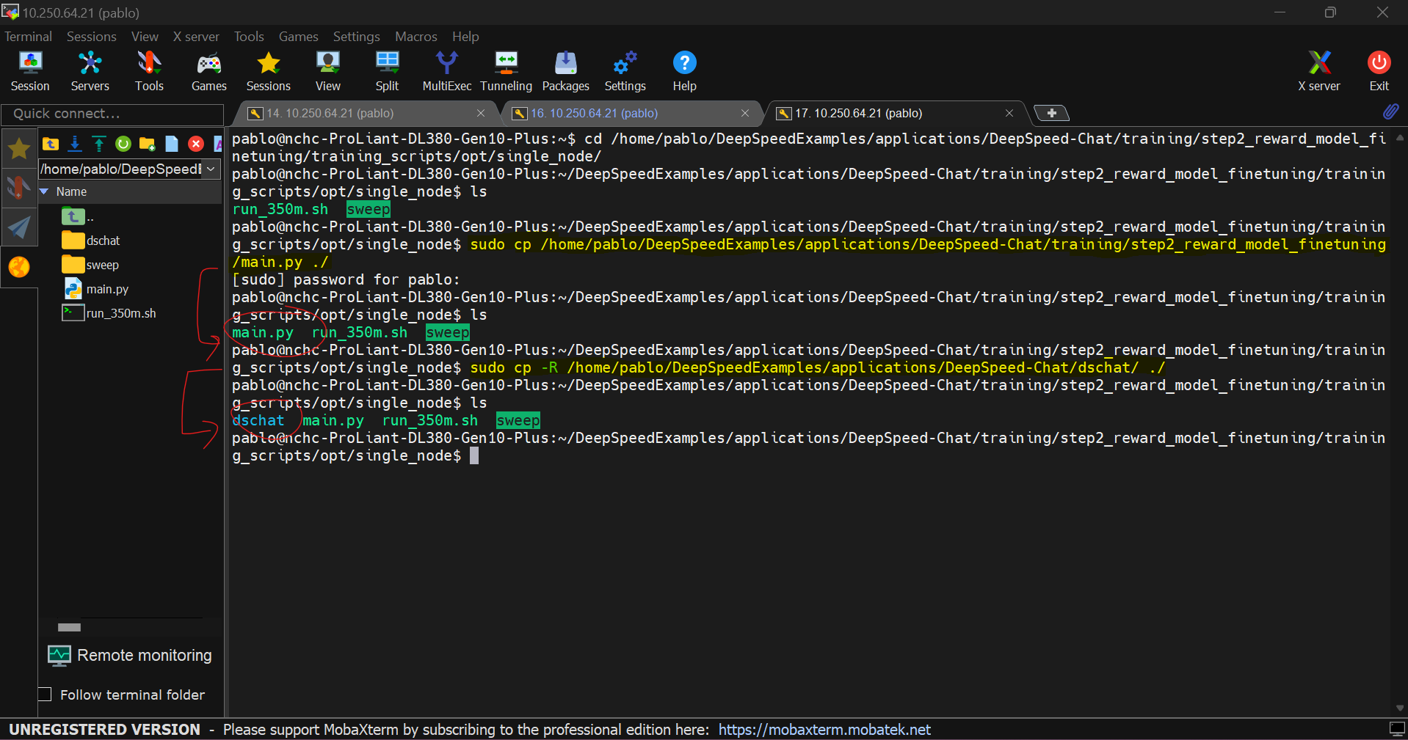
21

Slide 27
22

Slide 28
Step 3: RLHF Execution
Training_scripts
opt
Step3_rlhf_finetuning
dschat
main.py
output
Runnable scripts
Single_node
sweep
23

Slide 29
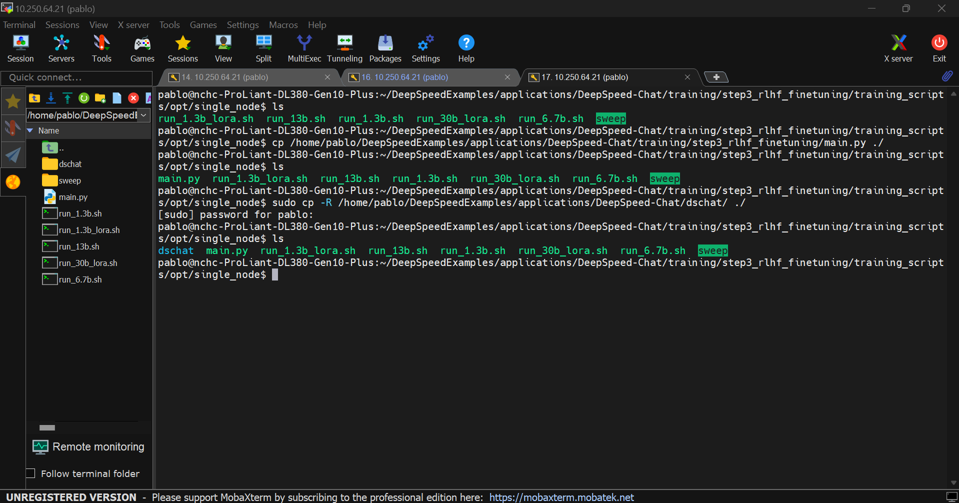
24

Slide 30
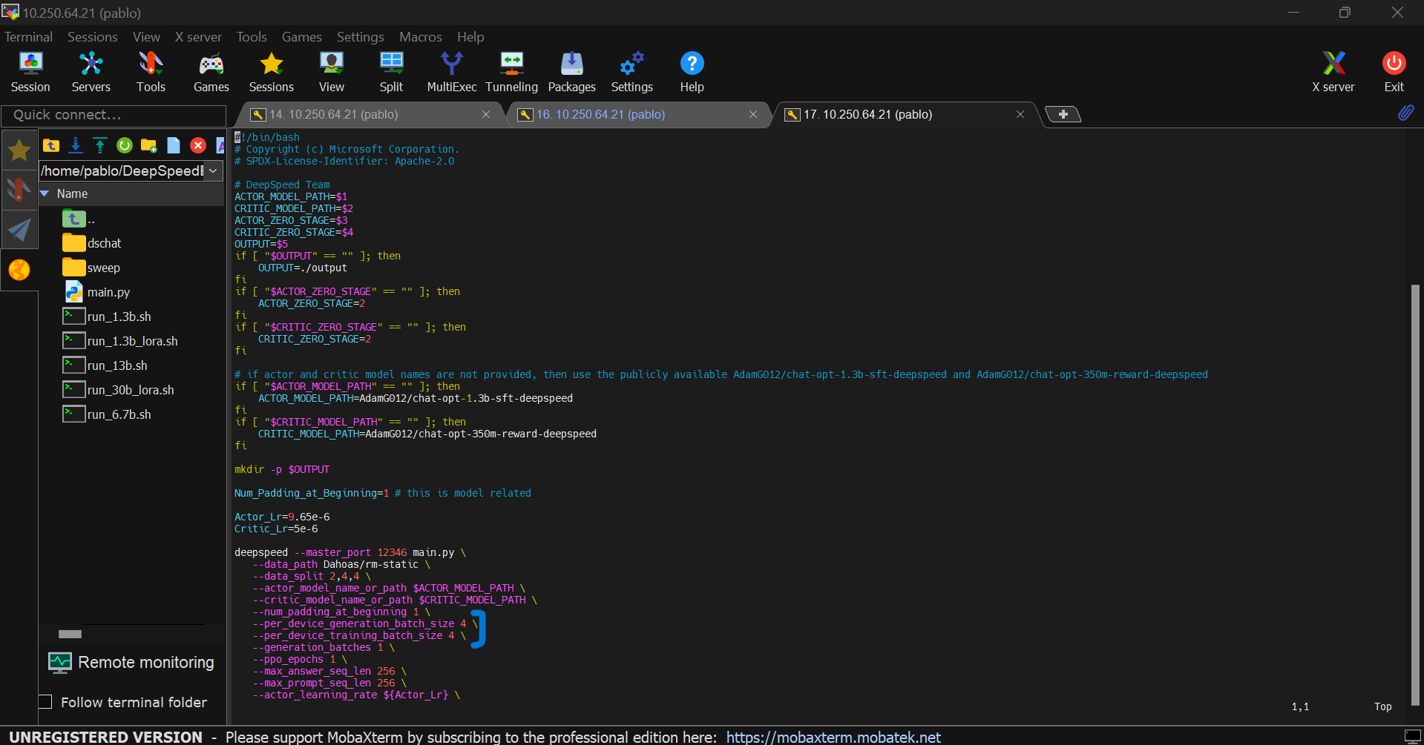
25

Slide 31
Model Testing
26

Slide 32




Project Ideas
Transformers - NLP
Goals: Prove training speed improvements + scalability + comparing resources usage + time + memory consumption (single GPU vs multi-GPU)
Speech Recognition
CNN – Computer Vision
13

